Slide 1
My Number Interactive Notebook
Name
Class
Teacher
Term 1 Semester 1
1

Slide 2
Objective
By the end of this lesson, you will be able to use the Distributive Law to simplify algebraic expressions involving multiple variables.

Slide 3
PBS MATH CLUB Video
Distributive Property – Friendship Bracelets and Oprah
https://youtu.be/n99K96Ektqo

Slide 4

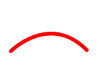

Distributive Law
24
7
30
Expanding Brackets
Date
EQ – How do I use the distributive law to expand expressions with more than two terms in the brackets?
From last class…
2 (y + 3) = 2xy + 2x3 = 2y+6 The “2” outside the brackets multiplies onto all letters and numbers that are inside the brackets.

Slide 5
Three Item Distributive Law
24
7
30
Expanding Brackets
Date
EQ – How do I use the distributive law to expand expressions with more than two terms in the brackets?
Now an example with 3 terms inside the brackets:
The rules stay the same.
2 (4e - y + 3) = 2x4e – 2xy + 2x3 = 8e - 2y + 6 The “2” outside the brackets is multiplied onto everything that is inside the brackets.

Slide 6
Three Item Distributive Law
24
7
30
Expanding Brackets
Date
EQ – How do I use the distributive law to expand expressions with more than two terms in the brackets?
Another examples with three terms…
7 (3a – 2b + 4) = 7x3a – 7x2b + 7x3 = 21a – 14b + 28 The “7” outside the brackets is multiplied onto everything that is inside the brackets.

Slide 7
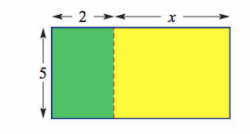
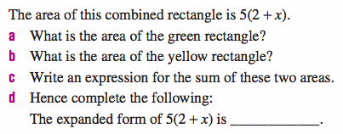
24
7
30
Expanding Brackets
Date
EQ – How do I use the distributive law to expand expressions with more than two terms in the brackets?
Let’s look at some visual
representations of the
Distributive Law

Slide 8
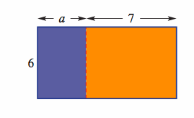
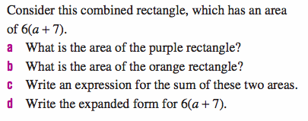
24
7
30
Expanding Brackets
Date
EQ – How do I use the distributive law to expand expressions with more than two terms in the brackets?

Slide 9
Write an expression that shows how to find the area of the rectangle and uses the distributive property.
5 yds
x yds
10 yds

Slide 10
Write an expression that shows how to find the area of the rectangle and uses the distributive property.
5 yds
5x
5 ∙ 10
x yds
10 yds

Slide 11
Write an expression that shows how to find the area of the rectangle and uses the distributive property.
5x +
5 ∙ 10
5 yds
x yds
10 yds

Slide 12


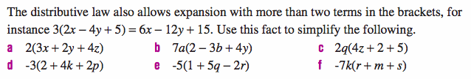
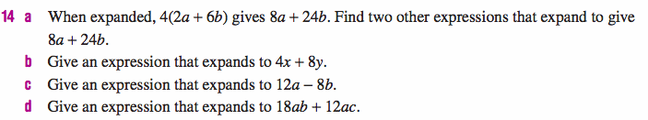
Class and Homework

